Slide 1
Kubernetes 101
Łukasz Kałużny
MVP: Microsoft Azure
Cloud Technology Leader @ Beyond.pl
kaluzny.io | @kaluzaaa
https://github.com/kaluzaaa/presentation/tree/master/2019

Slide 2
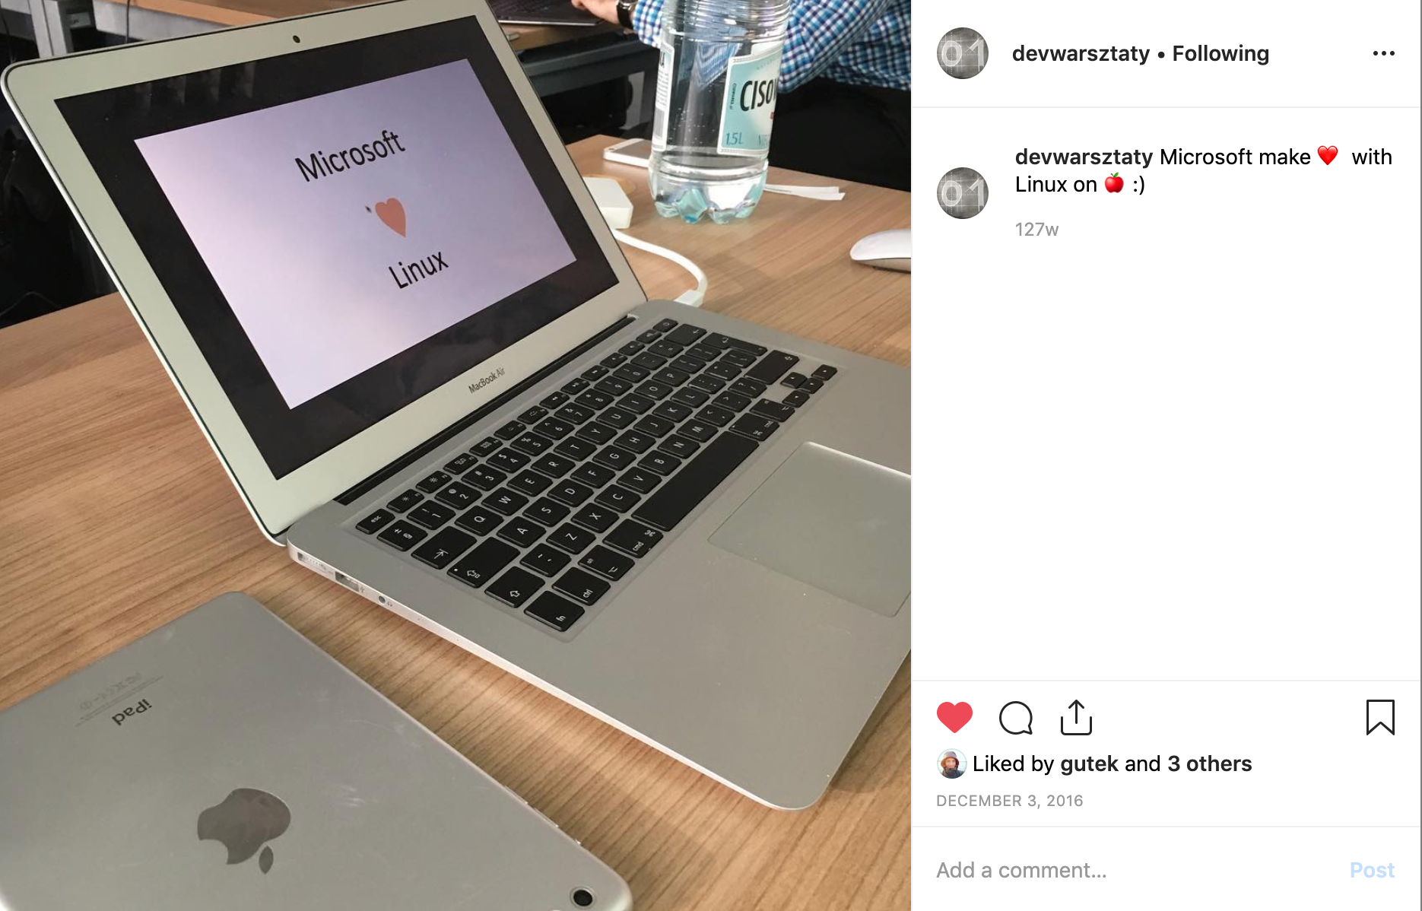

Slide 4
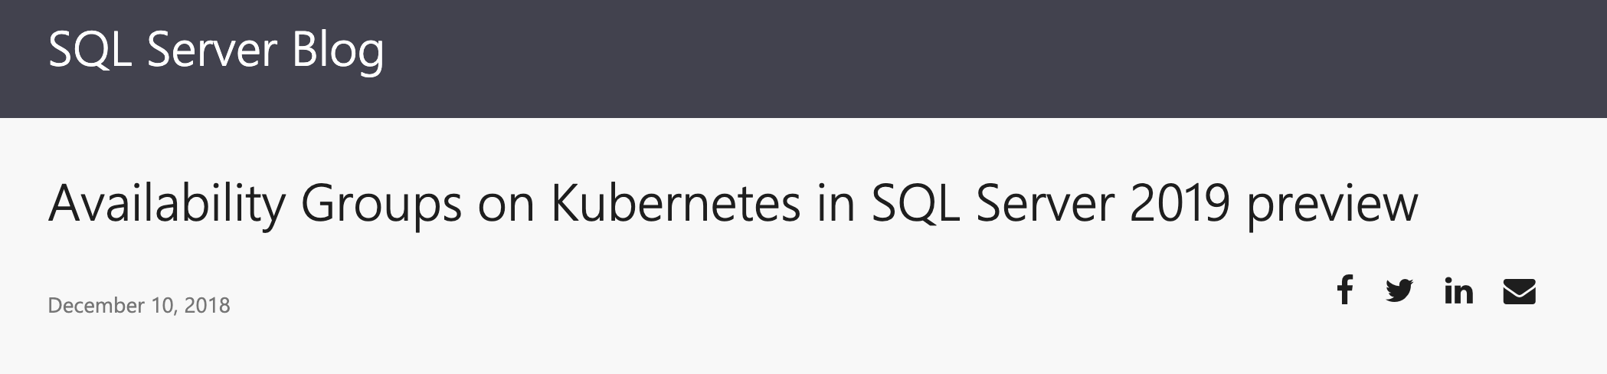

Slide 5
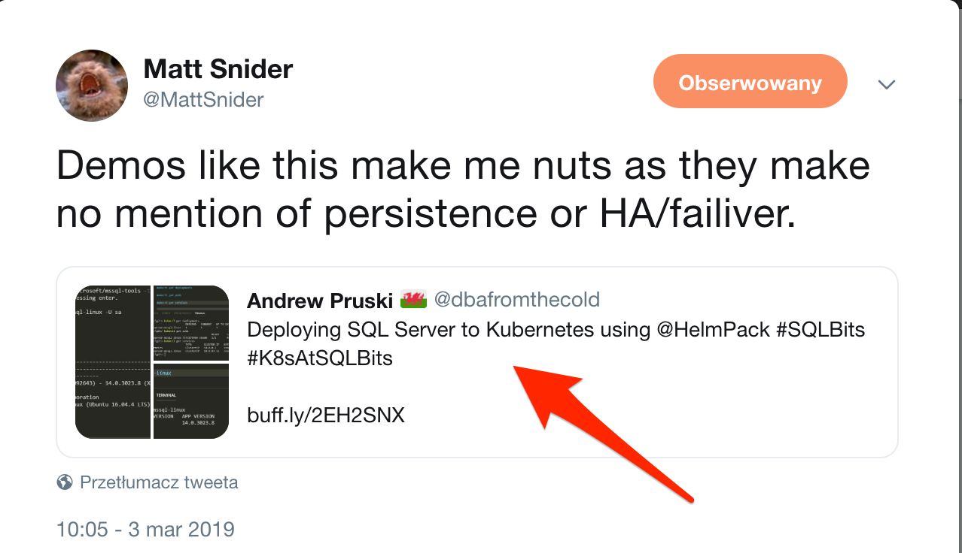

Slide 6

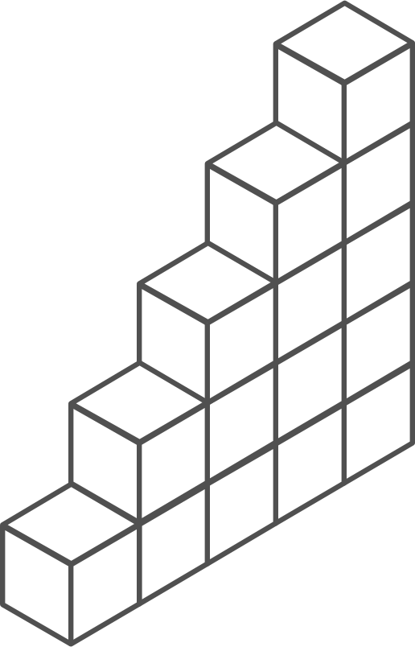
Containers and Kubernetes momentum
“By 2020, more than 50% of enterprises will run mission-critical, containerized cloud-native applications in production.”
Half of container environment is orchestrated.¹
77%
77% of companies² who use container orchestrators choose Kubernetes.
The average size of a container deployment has grown 75% in one year.¹
Larger companies are leading the adoption.¹
75%
50%
Nearly 50% of organizations¹ running 1000 or more hosts have adopted containers.
¹ Datadog report: 8 Surprising Facts About Real Docker Adoption
² CNCF survey: cloud-native-technologies-scaling-production-applications

Slide 7
Not a real thing.
An application delivery mechanism with process isolation.
Based on several Linux kernel features.
Namespaces (what a process can see)
Mount
Network
Cgroup
Cgroups (what a process can use)
Memory
CPU
What is a container?

Slide 8
Virtualization vs. Containerization
VM
VM
Container
App A
App B
App C
App A
App B
App C
App A
App B
App C
Bins/Libs
Bins/Libs
Bins/Libs
Guest OS
Guest OS
Guest OS
Bins/Libs
Bins/Libs
Bins/Libs
Bins/Libs
Bins/Libs
Bins/Libs
Hypervisor
Guest OS
Guest OS
Guest OS
Docker
Host OS
Hypervisor
Host OS
Infrastructure
Infrastructure
Infrastructure

Slide 9
Still…what is a Container?
Container Layer
Read / Write
From: Alpine:3.8
91e49dfb1179
d7b1189bf667
c220123c8472
Image layers
d31af33eb855
Read only
a7183fb762a8
f61792ba8979

Slide 10

The Container Advantage
Fast iteration
Agile delivery
Immutability
Cost savings
Efficient deployment
Elastic bursting
For developers
For IT

Slide 11
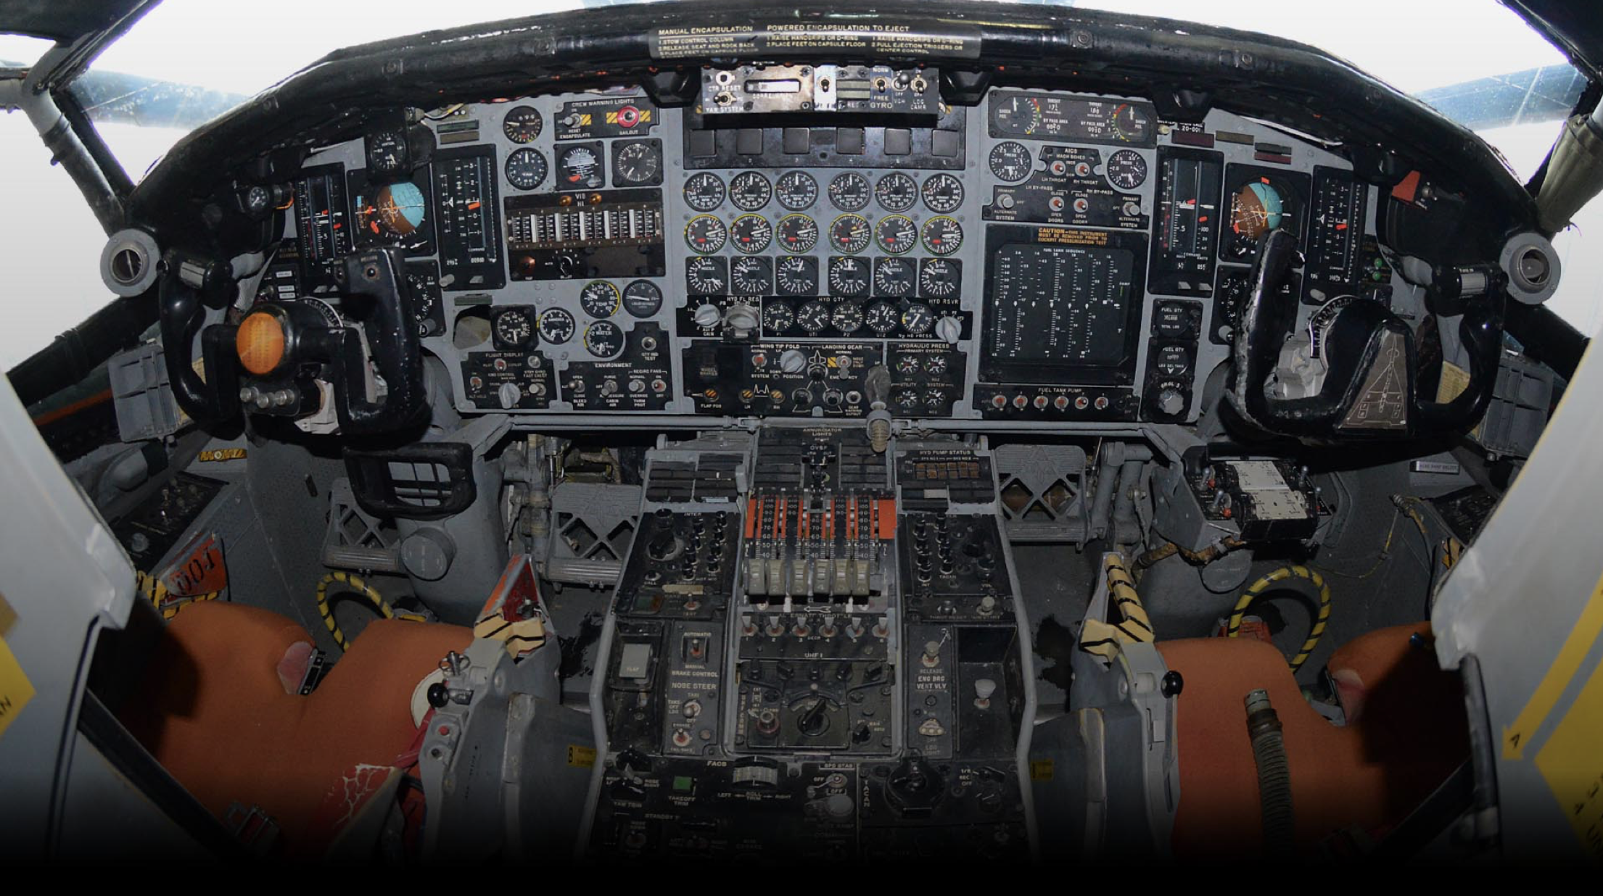

Slide 12
Features Include:
Self healing
Automatic Bin Packing
Service Discovery
Load Balancing
Secret Management
Automated roll backs and roll outs
Horizontal Scaling
Open source container orchestrator.
Designed to automate deployment, scaling, and management of applications.
What is Kubernetes?

Slide 13
Top scenarios for Kubernetes on Azure
Lift and shift to containers
Microservices
Machine learning
IoT
Cost saving
without refactoring your app
Agility
Faster application development
Performance
Low latency processing
Portability
Build once, run anywhere

Slide 14
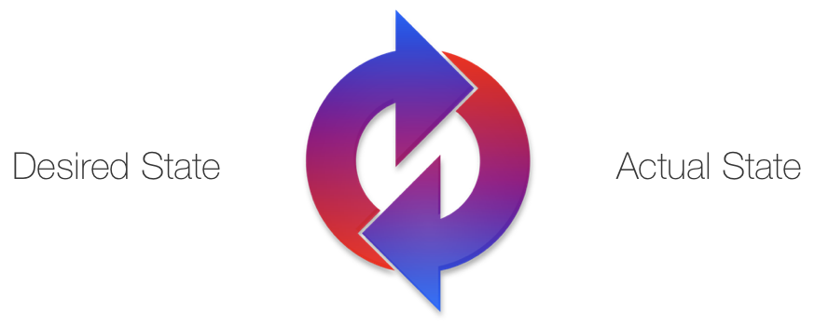
Reconciliation
Reconciliation Loop
Notes:
Kubernetes is a series of reconciliation loops that are constantly trying to reconcile the actual state toward the desired state specified by the declarative API

Slide 15
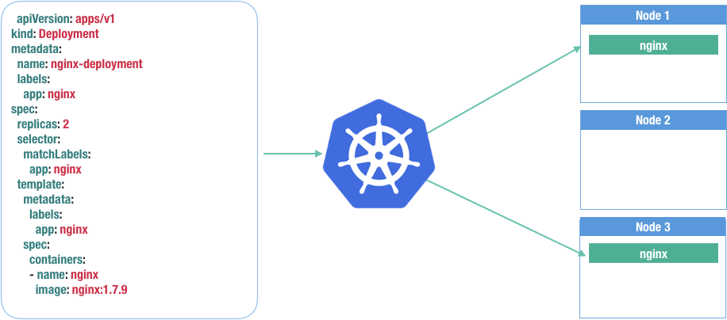
Reconciliation
Declarative Syntax

Slide 16
Kubernetes 101
Internet
Kubernetes control
Worker node
kubelet
kube-proxy
Kubernetes users communicate with API server and apply desired state
Master node
Docker
Master nodes actively enforce desired state on worker nodes
Prod
Prod
API server
Containers
Containers
Worker nodes support communication between containers
-controller-manager
-scheduler
Worker node
kubelet
kube-proxy
Worker nodes support communication from the Internet
replication, namespace, serviceaccounts, etc.
etcd
Docker
Prod
Prod
Containers
Containers

Slide 17
How managed Kubernetes on Azure works
Automated upgrades, patches
High reliability, availability
Easy, secure cluster scaling
Self-healing
API server monitoring
At no charge
Azure managed control plane
App/ workload definition
Self-managed master node(s)
User
Kubernetes API endpoint
API server
etcd Store
Scheduler
Controller Manager
Cloud Controller
Schedule pods over private tunnel
Customer VMs
Docker
Docker
Docker
Docker
Docker
Pods
Pods
Pods
Pods
Pods

Slide 18
Demo
Get started easily with AKS
Set up CI/CD in simple steps with DevOps Project
Notes:
Get started easily with AKS-Set up CI/CD in simple steps with DevOps Project;
Requires going to Portal, creating an Azure DevOps Project, and completing setup.

Slide 19
From infrastructure to innovation
Managed Kubernetes empowers you to do more
Focus on your containers and code, not the plumbing of them
Responsibilities | DIY with Kubernetes | Managed Kubernetes on Azure
Containerization
Application iteration, debugging
CI/CD
Cluster hosting
Cluster upgrade
Patching
Scaling
Monitoring and logging
Customer
Microsoft

Slide 20
make demo great again!
https://github.com/kaluzaaa/presentation/tree/master/2019

Slide 21






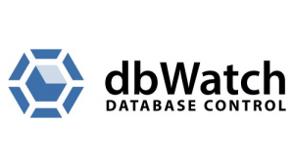


PLATINUM SPONSOR
GOLD SPONSORS
SILVER SPONSOR
BRONZE SPONSOR
STRATEGIC PARTNER

